Slide 1
HAND GESTURE ROCK PAPER SCISSORS

Slide 2
CONTENTS
INTRODUCTION
LITERATURE SURVEY
OBJECTIVES OF THE PROJECT
PROPOSED BLOCK DIAGRA
SOFTWARE AND HARDWARE TOOLS REQUIREMENTS
EXPECTED RESULTS
REFERENCES

Slide 3
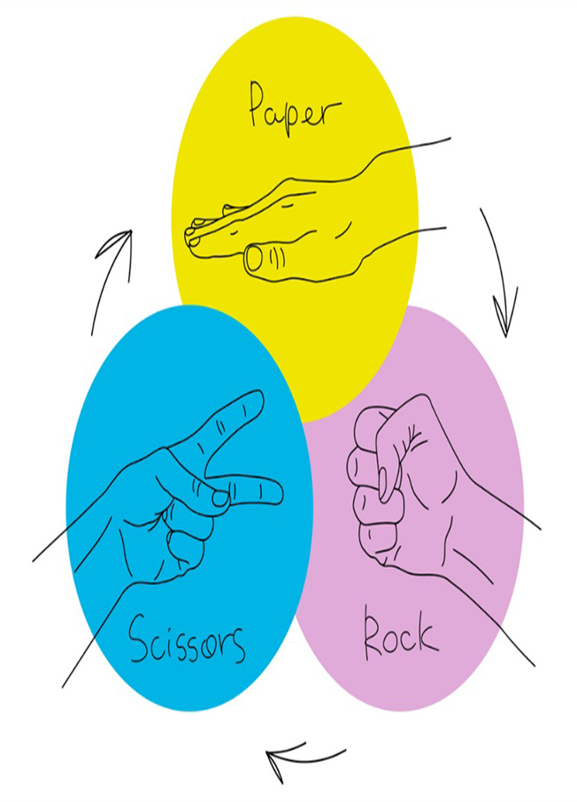
INTRODUCTION
Purpose: Clearly state the objective of the project, which is to develop a Python-based system for recognizing hand gestures representing rock, paper, and scissors.
Motivation: Explain the reasons behind this project, such as the interest in computer vision, human-computer interaction, or game development.
Overview: Provide a brief overview of the project, including the key components, methodologies, and expected outcomes.

Slide 4
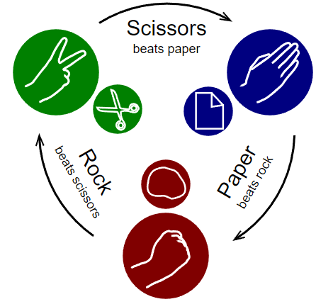
Hand gesture recognition plays a pivotal role in human-computer interaction (HCI), enabling intuitive and natural forms of communication with computers and devices.
The field has gained significant attention in recent years, particularly with advancements in computer vision and artificial intelligence. Unlike traditional input methods, such as keyboards or touchscreens, gesture recognition allows for more immersive and interactive experiences.
This project focuses on developing a vision-based system to detect hand gestures for the game Rock-Paper-Scissors. The game is a simple yet widely recognized one, making it an ideal subject for implementing and testing gesture recognition algorithms.
Rock-Paper-Scissors has three distinct gestures, allowing for a focused study of the methods needed to differentiate between the three outcomes. Moreover, as the game requires quick responses and a user-friendly interface, it serves as a practical case study for real-time gesture recognition systems.

Slide 5
LITERATURE SURVEY
A literature review for implementing the Rock-Paper-Scissors (RPS) game in Python can focus on several areas: the basics of game design in Python, algorithmic strategies for decision-making in simple games, artificial intelligence (AI) implementations for optimizing gameplay, and adaptations for multiplayer environments. Here’s a breakdown of each of these areas based on current research and popular coding practices.
1. Basic Game Design and Python Implementations
The Rock-Paper-Scissors game is a common introductory project in Python programming, allowing beginners to practice control structures, loops, and conditional statements. Many implementations use a straightforward approach where players input their choice, which is compared against a randomly selected choice for the computer.
Common Concepts:
Random Choice Generation: random.choice() is typically used for the computer's choice.Input Handling: User input validation ensures that players choose only valid options.Condition Statements: A series of if-else conditions to check the winner based on player and computer choices.
Examples:
Online tutorials and beginner courses often provide step-by-step implementations of RPS, focusing on the fundamentals of code structure, input validation, and feedback loops for game results.

Slide 6
2. Algorithmic Approaches and Decision-Making Strategies
While a basic RPS game relies on randomness, more advanced implementations use algorithmic strategies to make the game more challenging. Some variations include tracking patterns in player moves or using Markov chains to predict the player’s next move based on previous choices. These strategies are particularly useful in creating a non-random, "intelligent" opponent.
Common Strategies:
Pattern Recognition: Some algorithms track the player's past moves and attempt to predict future moves based on common patterns.Reinforcement Learning: Simple machine learning models can be trained to improve predictions over time by adjusting based on game outcomes.
Research in this area explores how games like RPS can be used to teach foundational AI concepts. These strategies can make the RPS game more dynamic and adaptable to the player's style.

Slide 7
3. Artificial Intelligence and Machine Learning Implementations
Incorporating AI into RPS takes the game from a beginner exercise to a more advanced project. Techniques include using probability-based models and reinforcement learning to create adaptive AI opponents.
Notable Techniques:Supervised Learning Models: AI models trained on datasets of player moves to improve prediction accuracy.Q-learning and Reinforcement Learning: The AI opponent learns optimal strategies by associating rewards with winning outcomes, improving performance through trial and error.
Studies have explored how AI in games like RPS can be used to simulate decision-making and adapt to human psychology. This approach is useful in testing and refining machine learning algorithms in a low-stakes environment.
4. Multiplayer and Web-Based Implementations
Creating a multiplayer version of RPS or deploying the game on a web platform involves additional considerations, such as network protocols for player communication and web frameworks for user interaction. Python frameworks like Flask or Django are often used to build web-based versions, and socket programming can be employed for real-time gameplay.

Slide 8
OBJECTIVES OF THE PROJECT
The primary goal of this project is to create a robust and efficient system for recognizing hand gestures associated with the game Rock-Paper-Scissors. Specifically, the objectives are as follows:
Real-Time Gesture Capture: Develop a system that captures hand gestures using a webcam and processes them in real-time. This involves video capture, image preprocessing, and gesture detection.
Accurate Gesture Recognition: Ensure the system can accurately classify gestures into one of the three categories: Rock, Paper, or Scissors. This requires a combination of image processing techniques and classification algorithms.
Gameplay Logic Implementation: Integrate game logic that compares the recognized gesture with a randomly generated gesture from the computer, determining the winner based on the game’s traditional rules.
User-Friendly Interface: Create an intuitive interface that allows users to interact with the system easily. The interface should clearly display the recognized gesture, the computer’s choice, and the outcome of the game.
Performance Optimization: Ensure the system operates efficiently, with minimal lag, to provide a smooth user experience.
This project not only serves as a demonstration of gesture recognition in gaming but also lays the foundation for future applications in more complex gesture-based systems. The success of this project would showcase the feasibility of using readily available tools to implement real-time gesture recognition systems for interactive applications.

Slide 9
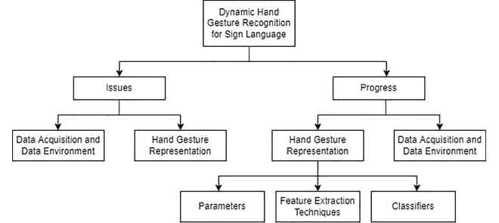
PROPOSED BLOCK DIAGRAM

Slide 10
SOFTWARE AND HARDWARE TOOLS REQUIRED
SOFTWARE REQUIREMENTS:
Python: Python was chosen as the primary programming language for this project due to its simplicity, flexibility, and extensive support for scientific computing. Python’s large ecosystem of libraries makes it ideal for rapid development and testing of computer vision algorithms.
OpenCV: OpenCV (Open Source Computer Vision Library) is a highly optimized library designed for real-time image processing. It provides numerous functions for image capture, filtering, contour detection, and other computer vision tasks. OpenCV’s ease of integration with Python made it the perfect choice for handling video input and preprocessing in this project.-
NumPy: NumPy is a fundamental package for numerical computing in Python. It provides support for large, multi-dimensional arrays and matrices, along with a collection of mathematical functions to operate on these arrays. NumPy is essential for handling the pixel data of images captured by the webcam and performing mathematical operations on them.
HARDWARE REQUIREMENTS:
Computer: A laptop or desktop computer with at least 8GB of RAM and a multi-core processor is recommended to ensure smooth operation. The computer serves as the primary platform for running the gesture recognition software, performing image processing, and executing the game logic.
Webcam: A webcam is used to capture real-time video input of the user’s hand gestures. The quality of the webcam affects the accuracy of gesture detection, with higher-resolution cameras providing more detailed input images, which can improve recognition accuracy. A webcam with a minimum resolution of 720p is recommended for this project.

Slide 11
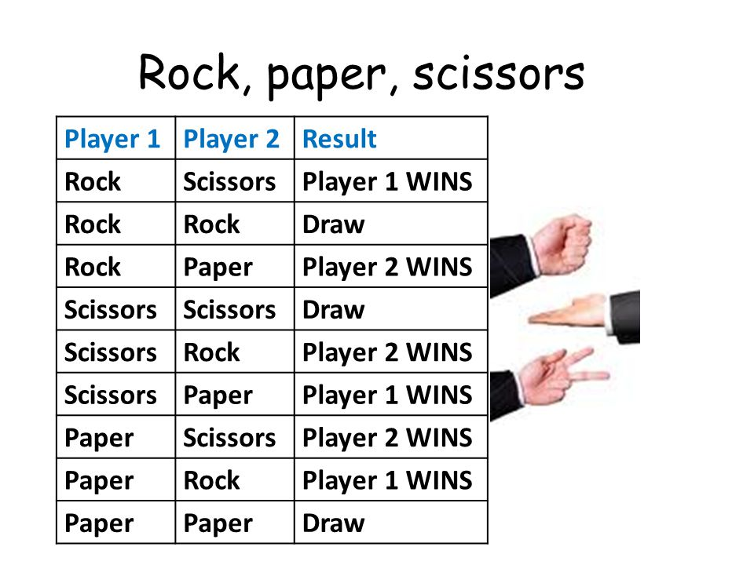
EXPECTED RESULTS
AI Gesture Selection: The AI should randomly choose one of the three gestures—Rock, Paper, or Scissors—each round.
Player Gesture Recognition: The system should accurately detect the player's hand gesture from the camera input in real-time.
Result Display: After both gestures are determined (player's and AI's), the system should immediately display the round result:
If the player’s gesture beats the AI's, it displays "Player Wins!"
If the AI's gesture beats the player's, it displays "AI Wins!"
If both gestures are the same, it displays "It's a Draw!“
Score Tracking: The system could keep a running score of the player and AI's wins for multiple rounds.
Game Feedback: The system should provide clear feedback on the player's gesture and AI's choice after each round, making the game engaging and easy to follow. This setup will create an interactive player vs. AI experience for "Rock, Paper, Scissors" using hand gestures.

Slide 12
REFERENCES
Gesture Recognition with OpenCV
OpenCV Python Tutorials. "Hand Gesture Recognition Using Python and OpenCV." - [OpenCV Documentation](https://opencv-python-tutroals.readthedocs.io/)
MediaPipe for Hand Detection
Google. "MediaPipe Hands Solution for Real-Time Hand Detection and Gesture Recognition." - [MediaPipe Hands Documentation](https://google.github.io/mediapipe/solutions/hands.html)
Machine Learning for Gesture Classification
TensorFlow. "Building a Hand Gesture Classifier with TensorFlow." - [TensorFlow Tutorials](https://www.tensorflow.org/tutorials)
AI and Randomization
Python Standard Library. "Random Module Documentation." - [Python Documentation](https://docs.python.org/3/library/random.html)
General Computer Vision Resources
- Rosebrock, Adrian. Practical Python and OpenCV. PyImageSearch. - [PyImageSearch Blog](https://www.pyimagesearch.com/)

